Slide 1
More CSS
COMP 3700

Slide 2
ALERTS
Small Project #2 available
On the course web site
Due Monday, 9/18
Don't forget to send me quiz screenshots

Slide 3
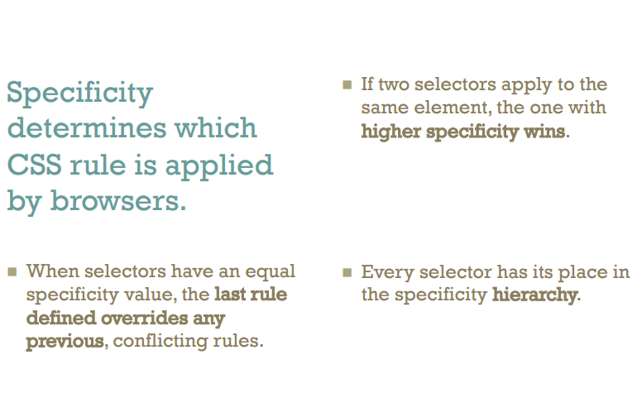

Slide 4
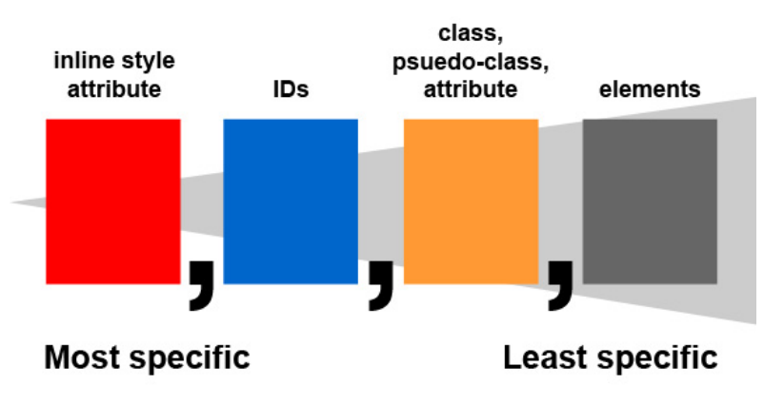

Slide 5
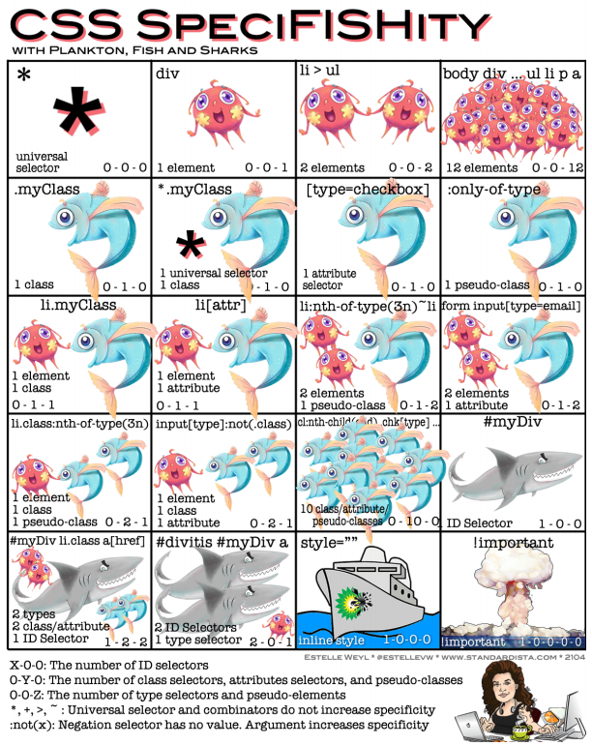

Slide 6
How To Include Rules
Inline
<p style=“text-align: center” >…</p>
Inside the head element
<link rel="stylesheet" type="text/css“ href="site.css" />
preferred!!
<style type="text/css">…</style>
<style type="text/css">
@import url(site.css);
/* other rules could go here */
</style>

Slide 7
Simple Example
Fonts and background colours
Inheritance and cascading
See simple in CSS examples

Slide 8
A Very Brief Overview of Visual Formatting With CSS
Visual Formatting
Fonts
Colors
Position
Box model and Borders
Dual presentation / Hiding CSS

Slide 9
Visual Formatting: fonts
Some major properties
font-family
body {font-family: Garamond, Times, serif}
Serif fonts and sans-serif fonts
font-size:
Length (em,ex), percentage, relative size, absolute size
font-style :
Normal, italic, oblique
font-weight:
Lighter, normal, bold, bolder, 100, 200, …, 800, 900

Slide 10
Visual Formatting: Colors
How to specify
140 Predefined names
Colors and the Web
RGB values
Wikipedia

Slide 11
Visual Formatting: Colors (cont.)
Major properties
background-color
color
transparent and inherit values

Slide 12
Visual Formatting: Images
position:
static, relative, absolute, fixed
Static — normal elements
Relative — translate from usual position
Absolute — scroll with the page
Fixed — like absolute, but don't scroll away
Example: Jon Gunderson

Slide 13
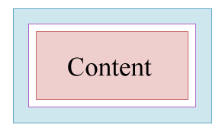
Visual Formatting: Box Model
Margin
Border
Padding
Figure from materials © by Dietel, Dietel, and Nieto
Notes:
From slides to accompany Internet & World Wide Web: How to Program by Dietel, et al. published by Prentice-Hall in 2000.

Slide 14
Borders? Do we have borders!
Four types again
Can all be set at once with border
See Border slides by Jon Gunderson

Slide 15
Box Model (Cont.)
Padding
Size in %, em, or ex for text
padding-top, padding-right, padding-bottom, padding-left
Mnemonic: TRouBLe
Set all at once with padding
Margin
Similar to padding
But can also be auto
see centring example
Width is of content only.
Neither the border nor the
padding are included in width.

Slide 16
CSS For Dual Presentation
What if users don't have CSS?
See button example
How can I make cool webpages?
One of many ways: see W3C Core Styles

Slide 17
A Trick For Dual Presentation
visibility:
visible or hidden
display:
none
visible:hidden
element can't be seen
but it still uses space
display:none
element isn't shown

